Slide 1


Muhammad Adeel
19-12-2025

Slide 2

Outline
Executive Summary
Introduction
Methodology
Results
Conclusion
Appendix

Slide 3
Executive Summary
This project analyzes SpaceX Falcon 9 launch data to identify the key factors influencing mission success, with the objective of supporting data-driven launch cost optimization.
A comprehensive end-to-end data science workflow was applied, including data collection via APIs and web scraping, data cleaning, exploratory data analysis, interactive visual analytics, and predictive modeling.
Multiple classification models were developed and evaluated to predict launch success, with tree-based and ensemble models achieving the strongest performance.
The analysis reveals that launch site selection, payload mass range, and booster version are critical drivers of success. In particular, newer Falcon 9 boosters (FT and Block 5) and optimized payload ranges (2,000–6,000 kg) demonstrate the highest success rates.
Overall, the project demonstrates how data analytics and machine learning can effectively translate historical launch data into actionable insights for improving reliability and reducing operational risk.

Slide 4
Introduction
Project Background and Context
SpaceX has transformed the commercial space industry by reusing Falcon 9 rocket boosters, significantly reducing launch costs compared to traditional space missions.
Predicting launch success is critical for understanding risk, reliability, and cost efficiency, especially as launch frequency increases.
This project uses historical Falcon 9 launch data to explore how operational factors influence mission outcomes.
Problems I Wanted to Find Answers To
Which launch sites have the highest number of successful missions and success rates?
How does payload mass impact the probability of a successful launch?
Do newer booster versions improve launch reliability compared to earlier designs?
Can machine learning models accurately predict launch success based on historical patterns?

Slide 5

Section 1

Slide 6
Methodology
Executive Summary
Data Collection: Launch data was gathered from the SpaceX REST API and supplemented using web scraping techniques to obtain detailed mission, payload, and booster information.
Data Wrangling & Processing: Raw data was cleaned, filtered, and transformed by handling missing values, standardizing formats, and creating relevant features required for analysis and modeling.
Exploratory Data Analysis (EDA): Both SQL queries and visualizations were used to explore relationships between launch success and key variables such as launch site, payload mass, and booster version.
Interactive Visual Analytics: Folium was used to analyze geographical patterns of launch sites, while Plotly Dash enabled interactive exploration of success rates across payload ranges and sites.
Predictive Modeling: Several classification models were built to predict launch success, and model performance was improved through hyper parameter tuning and cross-validation.
Model Evaluation: Models were evaluated using metrics such as accuracy and confusion matrices, ensuring reliable comparison and selection of the best-performing approach.

Slide 7
Data Collection
Multiple data sources were used to build a comprehensive and reliable dataset for Falcon 9 launch analysis.
Primary launch data was collected using the SpaceX REST API, providing structured information on launches, rockets, payloads, and outcomes.
Supplementary data was obtained through web scraping to capture additional details not directly available via the API, such as payload specifications and booster attributes.
Data from different sources was integrated and standardized to ensure consistency across variables and records.
The overall data collection workflow is summarized in the flowchart presented on the next slide, illustrating the step-by-step process from raw data extraction to structured datasets.

Slide 8
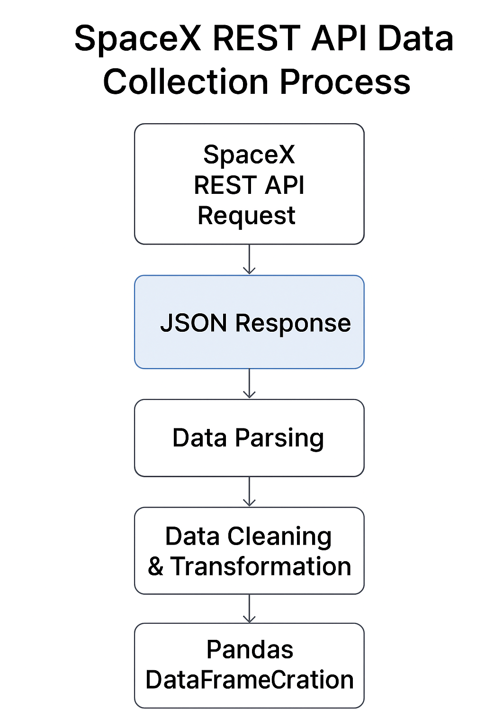
Data Collection – SpaceX API
Launch data was collected using SpaceX REST API calls, enabling direct access to structured and reliable mission data.
API endpoints were used to retrieve information related to:
Launch outcomes
Rocket and booster details
Payload mass and orbit types
Launch site locations
JSON responses from the API were parsed and converted into pandas Data Frames for further processing and analysis.
The collected data formed the core dataset used across EDA, visualization, and predictive modeling stages.
GitHub Notebook (SpaceX API Data Collection):
https://github.com/MuhammadAdeel-DataScientist/IBM-Applied-Data-Science-Capstone/blob/main/01-spacex-data-collection-api.ipynb

Slide 9
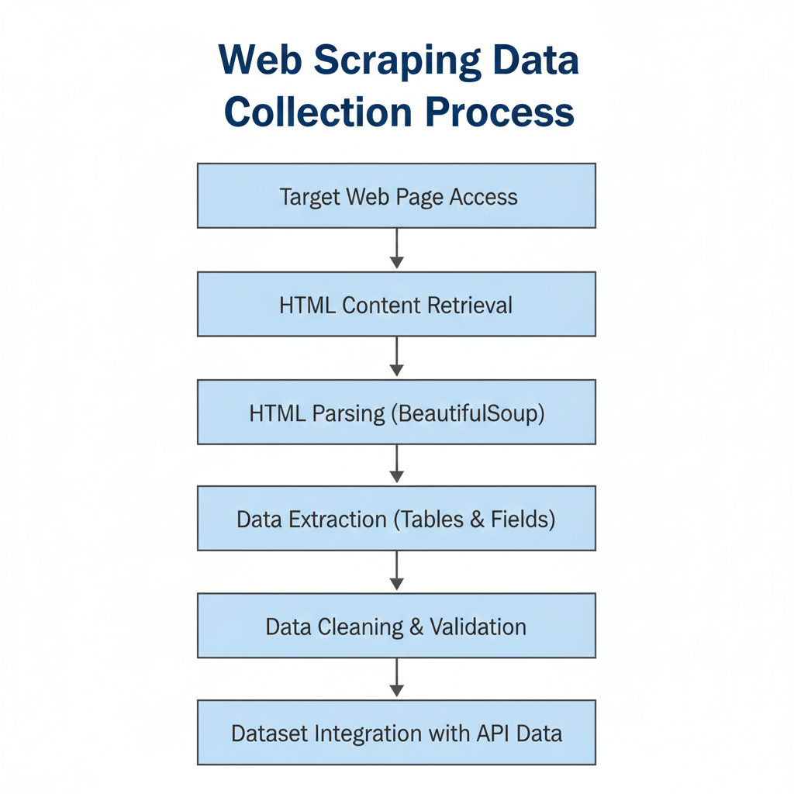
Data Collection - Scraping
Web scraping was used to supplement API data with additional mission and payload details not directly available through the SpaceX API.
HTML pages were accessed and parsed using Python-based scraping tools, enabling structured extraction of tabular launch information.
Relevant fields such as payload mass, orbit type, and mission metadata were extracted and validated for accuracy.
The scraped data was then cleaned, standardized, and merged with API-based datasets to form a unified analytical dataset.
GitHub Notebook (Web Scraping Data Collection):
https://github.com/MuhammadAdeel-DataScientist/IBM-Applied-Data-Science-Capstone/blob/main/02-webscraping.ipynb

Slide 10
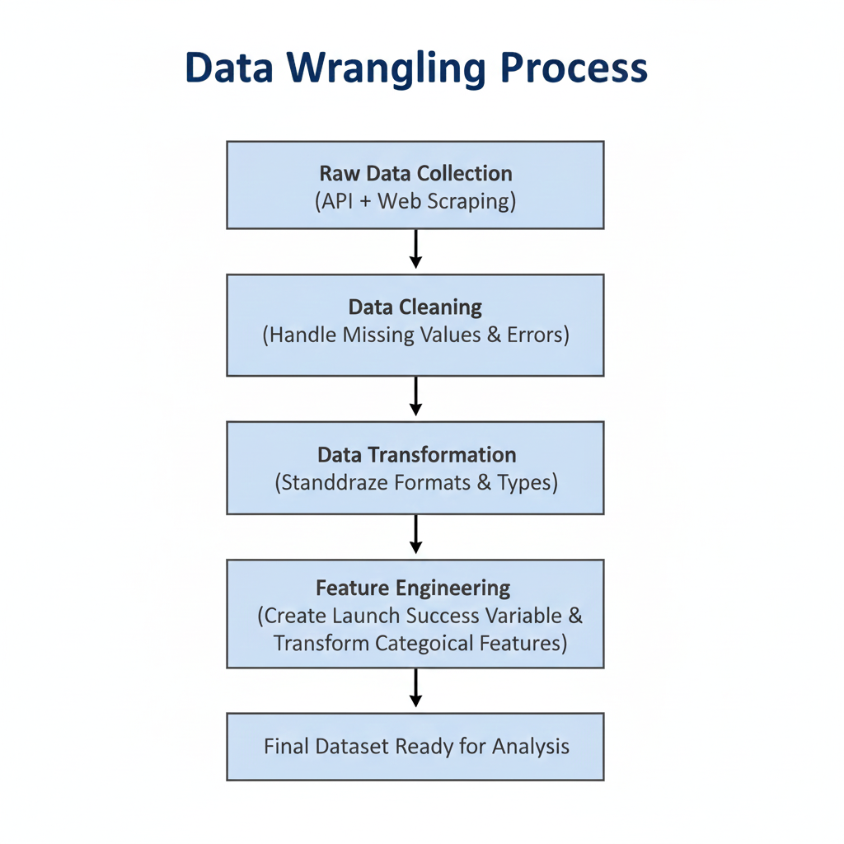
Data Wrangling
Raw datasets collected from SpaceX APIs and web scraping were combined into a single analytical dataset.
Missing values were identified and handled using appropriate strategies such as removal or imputation, depending on data relevance.
Data types were standardized and reformatted to ensure consistency across numerical, categorical, and temporal features.
Feature engineering was performed, including creation of the binary launch success variable and transformation of categorical fields.
The processed data was validated to ensure data quality, integrity, and readiness for EDA and modeling.
GitHub Notebook (Data Wrangling):
https://github.com/MuhammadAdeel-DataScientist/IBM-Applied-Data-Science-Capstone/blob/main/03-spacex-Data%20wrangling.ipynb

Slide 11
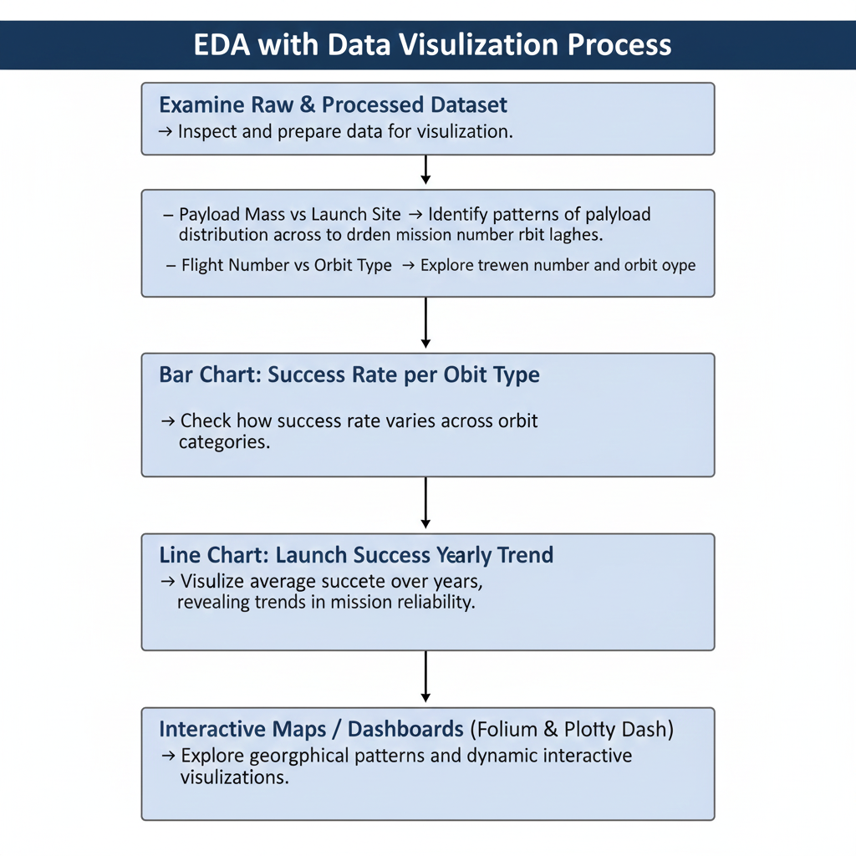
EDA with Data Visualization
Purpose: To explore relationships between launch success and key variables, uncover patterns, and generate insights to guide modeling and decision-making.
Charts Used & Rationale:
Bar Chart:
Success Rate per Orbit Type → Check how success rate varies across orbit categories.
Line Chart:
Launch Success Yearly Trend → Visualize average success rate over years, revealing trends in mission reliability.
Scatter Plots:
Payload Mass vs Launch Site → Identify patterns or differences in payload distribution across launch sites.
Flight Number vs Orbit Type → Explore trends between mission number and type of orbit.
GitHub Notebook (EDA & Data Visualization):
https://github.com/MuhammadAdeel-DataScientist/IBM-Applied-Data-Science-Capstone/blob/main/05-eda-data-Visualization.ipynb

Slide 12
EDA with SQL
Purpose: To explore SpaceX launch data using SQL queries, uncover key patterns, and generate insights for analysis and predictive modeling.
Key SQL Queries Performed:
Unique Launch Sites: Identified all distinct launch sites across missions.
Filter Launch Sites: Displayed first 5 records of sites starting with “CCA”.
Total Payload by Customer: Calculated total payload mass for NASA (CRS) missions.
Average Payload by Booster: Computed average payload for booster version F9 v1.1.
First Successful Ground Pad Landing: Found the date of first successful ground pad landing.
Booster Success with Payload Range: Listed boosters successful on drone ships with payload between 4000–6000 kg.
Mission Outcome Counts: Counted total successful vs. failed landings.
Max Payload Booster: Identified booster versions that carried the maximum payload mass.
Failures in 2015: Retrieved failure outcomes for drone ship landings by month, booster, and site.
Landing Outcome Rankings: Ranked landing outcome counts between 2010-06-04 and 2017-03-20.
Database Connection & Setup: Loaded dataset into SQLite, removed blank rows, and created the final table for querying.
GitHub Notebook (EDA with SQL):
https://github.com/MuhammadAdeel-DataScientist/IBM-Applied-Data-Science-Capstone/blob/main/04-eda-sql-sqllite.ipynb

Slide 13
Build an Interactive Map with Folium
Purpose: Perform interactive spatial analysis of SpaceX launch sites to understand their geographical patterns, proximities, and operational relevance.
Map Objects Created & Their Purpose:
Markers & MarkerCluster: Placed at each launch site and for each launch record (green = success, red = failure) → Simplifies visualization of multiple launches at the same location.
Circles: Highlighted launch site locations → Emphasize site boundaries and visibility on the map.
PolyLines: Drawn from launch sites to nearby coastlines, railways, highways, and cities → Analyze distances to critical infrastructure and safety zones.
MousePosition Plugin: Shows coordinates on hover → Facilitates manual identification of nearby points for distance calculations.
DivIcon Labels: Custom text labels for sites and markers → Improves readability and clarity of site names and distances.
Key Insights from Interactive Map:
Launch sites are close to railways and highways for logistical support.
Positioned moderately from coastlines to minimize risk over populated areas.
Significant distance from cities ensures public safety.
Marker clusters highlight sites with high success rates visually.
GitHub Notebook (Interactive Folium Map):
https://github.com/MuhammadAdeel-DataScientist/IBM-Applied-Data-Science-Capstone/blob/main/06-Intractive-Analytics-launch_site_location.ipynb

Slide 14
Build a Dashboard with Plotly Dash
Purpose: Create an interactive dashboard to explore SpaceX launch data dynamically, enabling stakeholders to analyze launch outcomes and payload impacts across different launch sites.
Dashboard Components & Interactions:
Dropdown Menu (Launch Site Selection):
Allows users to select a specific launch site or view all sites.
Dynamically updates charts for focused or overall analysis.
Pie Chart (Success Counts by Site / Success vs Failure per Site):
Shows total successful launches for all sites or the success/failure ratio for a selected site.
Supports visual comparison of performance across sites.
Payload Range Slider:
Filters missions by payload mass dynamically.
Enables users to analyze launch success patterns for different payload ranges.
Scatter Chart (Payload vs Launch Outcome):
Plots payload mass against launch success, colored by booster version category.
Reveals trends between payload and mission outcome, and differences across booster versions.
Key Insights Enabled by the Dashboard:
Quickly identify which sites have higher success rates.
Explore payload-dependent risks and booster effectiveness.
Interactive filters allow scenario analysis for different launch sites and payload ranges.
GitHub Notebook (Plotly Dash Dashboard):
https://github.com/MuhammadAdeel-DataScientist/IBM-Applied-Data-Science-Capstone/blob/main/07-Intractive-Dashboard.py

Slide 15
Predictive Analysis (Classification)
Objective: Predict whether the Falcon 9 first stage will land successfully to estimate launch cost and aid competitive bidding.
Model Development Process:
Data Preprocessing:
Extracted class labels from dataset (Class column) → Y.
Standardized features (X) using StandardScaler.
Split data into training (80%) and testing (20%) sets.
Exploratory Data Analysis (EDA):
Investigated relationships between payload, booster version, and landing success.
Visualized class distributions and feature correlations.
Model Selection & Hyperparameter Tuning:
Logistic Regression → GridSearchCV for C and penalty.
Support Vector Machine (SVM) → tuned kernel, C, gamma.
Decision Tree → tuned criterion, max_depth, max_features, min_samples_split/leaf.
K-Nearest Neighbors (KNN) → tuned n_neighbors, algorithm, p.

Slide 16
Predictive Analysis (Classification) continue
Model Evaluation:
Used confusion matrix, test accuracy, and cross-validation score.
Compared all models on test data:
Model | Test Accuracy
Logistic Regression | 0.8333
SVM | 0.8333
Decision Tree | 0.6667
KNN | 0.7778
Best Performing Model : Logistic Regression (Test Accuracy: 0.8333)
Key Insights:
Logistic Regression and SVM performed best for landing prediction.
Decision Trees underperformed due to overfitting on limited data.
Feature standardization and hyper parameter tuning significantly improved model performance.

Slide 17
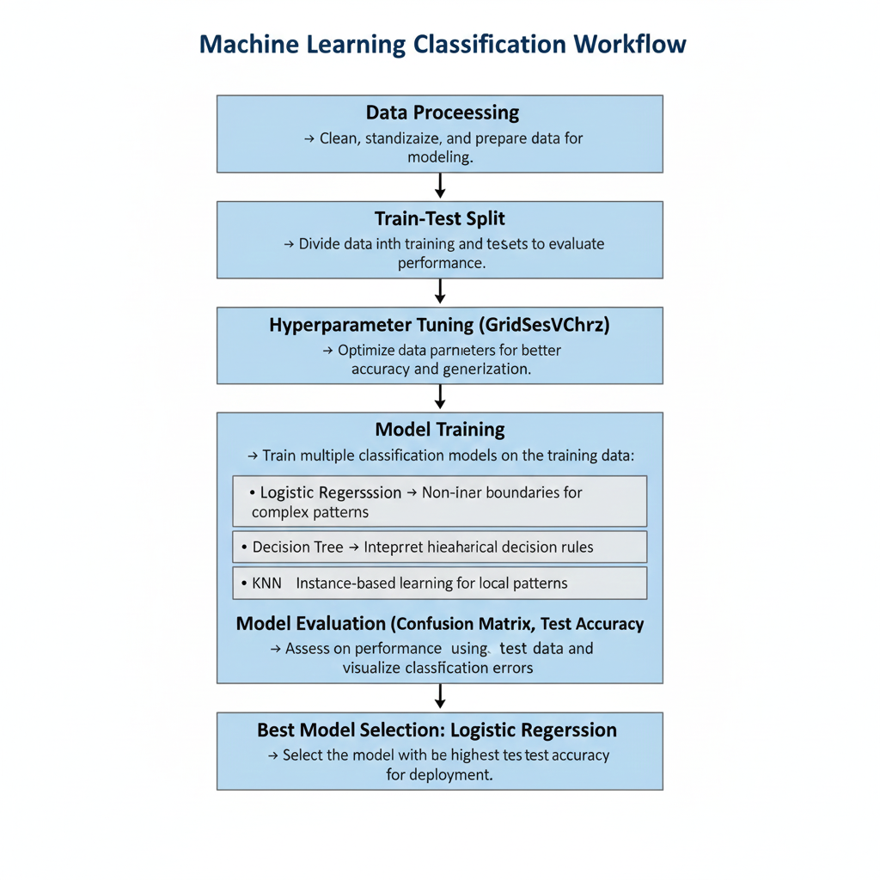
Predictive Analysis (Classification) continue
GitHub Notebook (Predictive Analysis Lab):
https://github.com/MuhammadAdeel-DataScientist/IBM-Applied-Data-Science-Capstone/blob/main/08-SpaceX_Machine%20Learning%20Prediction_Part_5.ipynb

Slide 18
Results
Exploratory Data Analysis (EDA): (Section 2) Initial visual and SQL-based analysis revealed clear patterns in launch success related to payload mass, orbit type, launch site, and booster version.
Launch Site Proximity Analysis: (section 3)
Geospatial analysis showed that launch sites are strategically located away from major cities, close to coastlines, and near transportation infrastructure such as railways, supporting operational safety and logistics efficiency.
Interactive Visual Analytics: (Section 4) An interactive dashboard was developed to dynamically explore launch success across sites and payload ranges, enabling deeper insight through user-driven analysis.
Predictive Analysis: (Section 5) Multiple classification models were trained to predict first-stage landing success, with one model outperforming others and selected as the final predictive solution.

Slide 19

Section 2

Slide 20
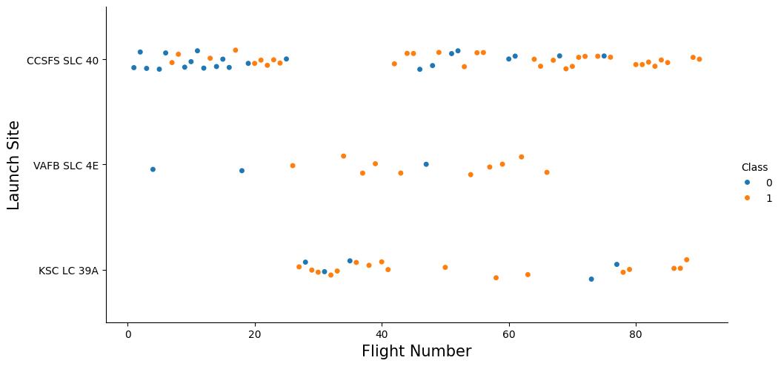
Flight Number vs. Launch Site
Key Insights
Early flights show higher variability and more failures.
Launch success improves as flight number increases.
KSC LC-39A appears more frequently in later, mature missions.
Interpretation
Increased flight experience leads to improved reliability.
Launch site usage evolves as SpaceX gains operational confidence.

Slide 21
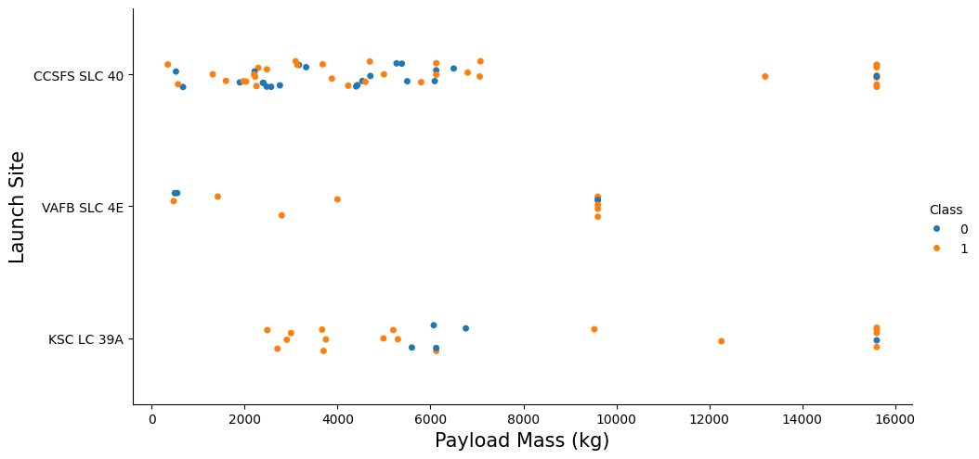
Payload vs. Launch Site
Key Insights
Higher payload missions are concentrated at specific launch sites.
KSC LC-39A supports a wider range of payload masses.
Lower payload launches show more variability across sites.
Interpretation
Payload capacity influences launch site selection.
Mature launch sites are preferred for heavier and high-value missions.

Slide 22
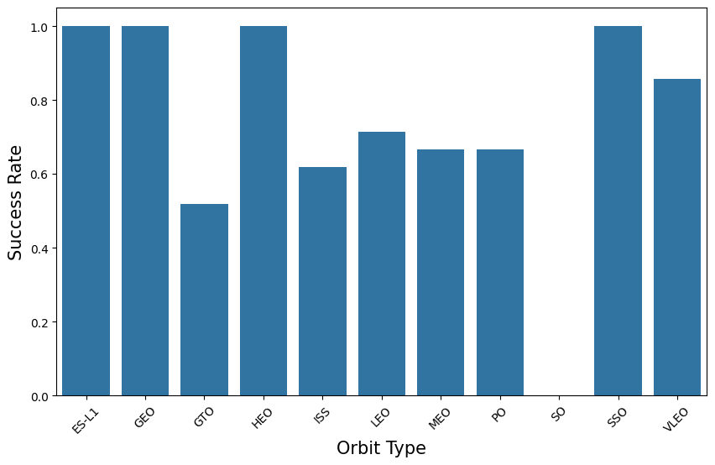
Success Rate vs. Orbit Type
Key Insights
ES-L1, GEO & HEO orbit show consistently higher success rates.
More complex orbits exhibit slightly lower and more variable success rates.
Interpretation
Orbit complexity impacts mission difficulty and success probability.
SpaceX achieves greater reliability on frequently flown orbit types.

Slide 23
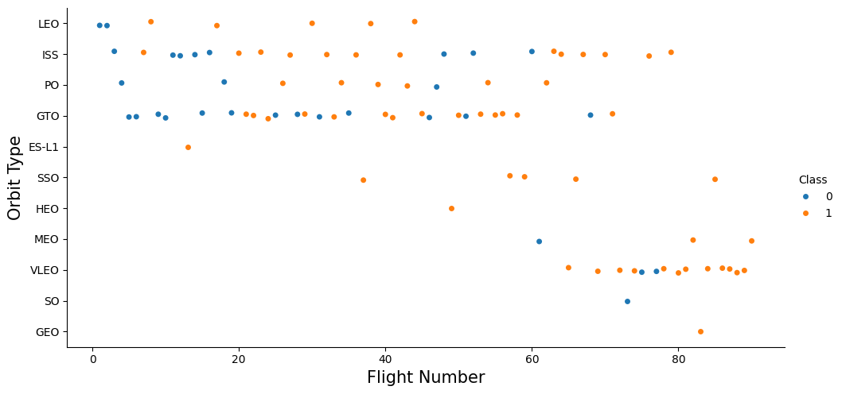
Flight Number vs. Orbit Type
Key Insights
In LEO orbits, launch success improves as flight number increases.
After approximately 5 flights, LEO missions achieve near 100% success.
GTO orbits show no clear relationship between flight number and success.
Success outcomes in GTO remain variable across missions.
Interpretation
Repeated launches in LEO benefit from operational learning and optimization.
GTO missions remain inherently complex, limiting gains from experience alone.

Slide 24
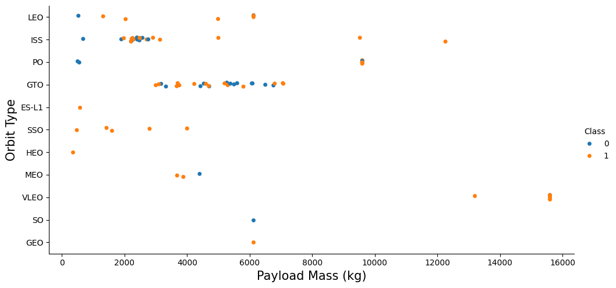
Payload vs. Orbit Type
Key Insights
Higher payload masses show higher success rates in LEO, ISS, and Polar orbits.
Successful landings dominate these orbits even at heavy payload levels.
In GTO orbits, both successful and unsuccessful landings occur across payload ranges.
Payload mass alone does not clearly separate outcomes for GTO missions.
Interpretation
Certain orbit types (LEO, ISS, Polar) are more tolerant of heavier payloads due to optimized mission profiles.
GTO missions remain more challenging, where success depends on additional factors beyond payload mass.

Slide 25
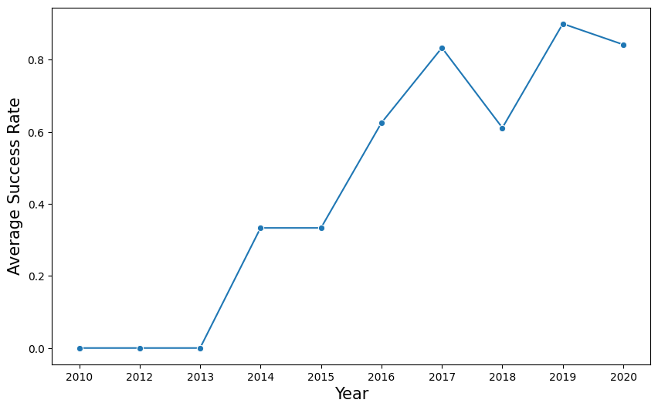
Launch Success Yearly Trend
Key Insights
The average launch success rate increases steadily from 2013 onward.
Early years show lower and more variable success rates.
From 2017 to 2020, success rates remain consistently high.
Indicates a clear upward trend in mission reliability over time.
Interpretation
The rising success trend reflects technological improvements and operational learning.
Increased experience, better booster reuse strategies, and refined processes contributed to improved outcomes.

Slide 26
All Launch Site Names
Query Used:
SELECT DISTINCT Launch_Site FROM SPACEXTABLE;
Unique Launch Sites Identified:
CCAFS LC-40
VAFB SLC-4E
KSC LC-39A
CCAFS SLC-40
Explanation: This query retrieves all distinct launch sites from the SpaceX dataset. Identifying unique sites helps us understand the geographical distribution of launches and sets the stage for analyzing site-specific performance and trends.

Slide 27
Launch Site Names Begin with 'CCA'
Query Used:
SELECT * FROM SPACEXTABLE WHERE Launch_Site LIKE 'CCA%‘ LIMIT 5;
Sample Records (First 5):
Date | Time (UTC) | Booster Version | Launch Site
2010-06-04 | 18:45:00 | F9 v1.0 B0003 | CCAFS LC-40
2010-12-08 | 15:43:00 | F9 v1.0 B0004 | CCAFS LC-40
2012-05-22 | 07:44:00 | F9 v1.0 B0005 | CCAFS LC-40
2012-10-08 | 00:35:00 | F9 v1.0 B0006 | CCAFS LC-40
2013-03-01 | 15:10:00 | F9 v1.0 B0007 | CCAFS LC-40
Explanation: This query filters launch records where the launch site starts with 'CCA', highlighting missions from Cape Canaveral Air Force Station. Showing a few sample records allows stakeholders to see payload types, mission outcomes, and launch cadence from this primary launch location.

Slide 28
Total Payload Mass
Query Used:
SELECT SUM(PAYLOAD_MASS__KG_) AS Total_Payload_Mass FROM SPACEXTABLE WHERE Customer LIKE '%NASA%';
Result: Total Payload Mass from NASA missions: 107,010 kg
Explanation: This query calculates the cumulative payload mass carried by all boosters for NASA missions. Tracking the total payload provides insight into mission scale, operational capacity, and the contribution of NASA-related launches to overall SpaceX payload delivery.

Slide 29
Average Payload Mass by F9 v1.1
Query Used:
SELECT AVG(PAYLOAD_MASS__KG_) AS Avg_Payload_Mass FROM SPACEXTABLE WHERE Booster_Version = 'F9 v1.1';
Result: Average Payload Mass for F9 v1.1 launches: 2,928.4 kg
Explanation: This query calculates the average payload mass carried by the F9 v1.1 booster version. Understanding the average payload helps evaluate the performance and capacity improvements of this booster version compared to earlier or later variants.

Slide 30
First Successful Ground Landing Date
Query Used:
SELECT MIN(Date) AS First_Successful_GroundPad_Landing FROM SPACEXTABLE WHERE Landing_Outcome = 'True RTLS';
Result: December 22, 2015 was the date when SpaceX achieved its first successful ground landing of a Falcon 9 booster at Landing Zone 1 near Cape Canaveral, Florida.
Explanation: This event marked a historic milestone in reusable rocketry the first time a Falcon 9 first stage returned from an orbital launch and landed vertically on a ground pad. This breakthrough demonstrated the feasibility of booster recovery and reuse, significantly reducing launch costs and paving the way for routine rocket landings

Slide 31
Successful Drone Ship Landing with Payload between 4000 and 6000
Query Used:
SELECT Booster_Version FROM SPACEXTABLE WHERE Landing_Outcome LIKE 'True ASDS%‘ AND PAYLOAD_MASS__KG_ BETWEEN 4000 AND 6000;
Result:
F9 FT B1022
F9 FT B1026
F9 FT B1021.2
F9 FT B1031.2 Explanation: This analysis filters for missions where the first‑stage boosters both returned safely to a drone ship landing platform and launched payloads weighing between 4,000 kg and 6,000 kg. Identifying these boosters helps illustrate SpaceX’s capability to achieve precision sea landings even under significant payload loads, a key metric of operational reusability performance.

Slide 32
Total Number of Successful and Failure Mission Outcomes
Query Used:
SELECT Landing_Outcome, COUNT(*) AS Total_Missions FROM SPACEXTABLE GROUP BY Landing_Outcome;
Result Summary:
Explanation: Most missions in the dataset ended successfully, including landings on ground pads and drone ships, highlighting SpaceX’s high operational reliability. Failures reflect unsuccessful recoveries or partial mission issues, while the overall success rate for Falcon launches remains very high.
Landing Outcome | Total Missions
Success | 38
Success (drone ship) | 14
Success (ground pad) | 9
Controlled (ocean) | 5
Failure (drone ship) | 5
Failure | 3
Failure (parachute) | 2
Uncontrolled (ocean) | 2
No attempt | 22 (aggregated)
Precluded (drone ship) | 1

Slide 33
Boosters Carried Maximum Payload
Query Used:
SELECT Booster_Version, PAYLOAD_MASS__KG_
FROM SPACEXTABLE WHERE PAYLOAD_MASS__KG_ = ( SELECT MAX ( PAYLOAD_MASS__KG_ ) FROM SPACEXTABLE);
Result:
The following Falcon 9 Block 5 boosters each carried the maximum recorded payload mass of 15,600 kg in the dataset:
F9 B5 B1048.4 F9 B5 B1049.4 F9 B5 B1051.3 F9 B5 B1056.4 F9 B5 B1048.5 F9 B5 B1051.4
F9 B5 B1049.5 F9 B5 B1060.2 F9 B5 B1058.3 F9 B5 B1051.6 F9 B5 B1060.3 F9 B5 B1049.7
Explanation: Multiple Falcon 9 Block 5 boosters carried the maximum payload of 15,600 kg in the dataset. This matches SpaceX’s documented performance, where Falcon 9 Block 5 can deliver up to ~22,800 kg to LEO in ideal conditions and around ~17,400 kg in reusable mode, consistent with real missions.

Slide 34
2015 Launch Records
Query Used:
SELECT CASE substr(Date,6,2) WHEN '01' THEN 'January‘ WHEN '02' THEN 'February‘ WHEN '03' THEN 'March‘ WHEN '04' THEN 'April‘ WHEN '05' THEN 'May‘ WHEN '06' THEN 'June‘ WHEN '07' THEN 'July‘ WHEN '08' THEN 'August‘ WHEN '09' THEN 'September‘ WHEN '10' THEN 'October‘ WHEN '11' THEN 'November' WHEN '12' THEN 'December' END AS Month, Booster_Version, Launch_Site, Landing_Outcome FROM SPACEXTABLE WHERE substr(Date,1,4) = '2015‘ AND Landing_Outcome LIKE 'Failure (drone ship)%';
Result:
Explanation: In 2015, two first‑stage boosters (B1012 and B1015) attempted landings on a drone ship after launch from Cape Canaveral Air Force Station (CCAFS LC‑40) but failed to land successfully. These early ocean landing tests came before SpaceX’s first successful sea landing in 2016 and reflect the iterative testing phase of booster recovery.
Month | Booster Version | Launch Site | Landing Outcome
January | F9 v1.1 B1012 | CCAFS LC‑40 | Failure (drone ship)
April | F9 v1.1 B1015 | CCAFS LC‑40 | Failure (drone ship)

Slide 35
Rank Landing Outcomes Between 2010-06-04 and 2017-03-20
Query Used:
SELECT Landing_Outcome, COUNT(*) AS Outcome_Count FROM SPACEXTABLE WHERE Date BETWEEN '2010-06-04' AND '2017-03-20‘ GROUP BY Landing_Outcome ORDER BY Outcome_Count DESC;
Result:
Explanation:
Between June 2010 and March 2017, most missions had “No attempt” at landing. Sea‑landings on drone ships show a mix of successes and failures, while ground pad and ocean recoveries reflect the early development of booster recovery techniques.
Landing Outcome | Count
No attempt | 10
Success (drone ship) | 5
Failure (drone ship) | 5
Success (ground pad) | 3
Controlled (ocean) | 3
Uncontrolled (ocean) | 2
Failure (parachute) | 2
Precluded (drone ship) | 1

Slide 36

Section 3

Slide 37
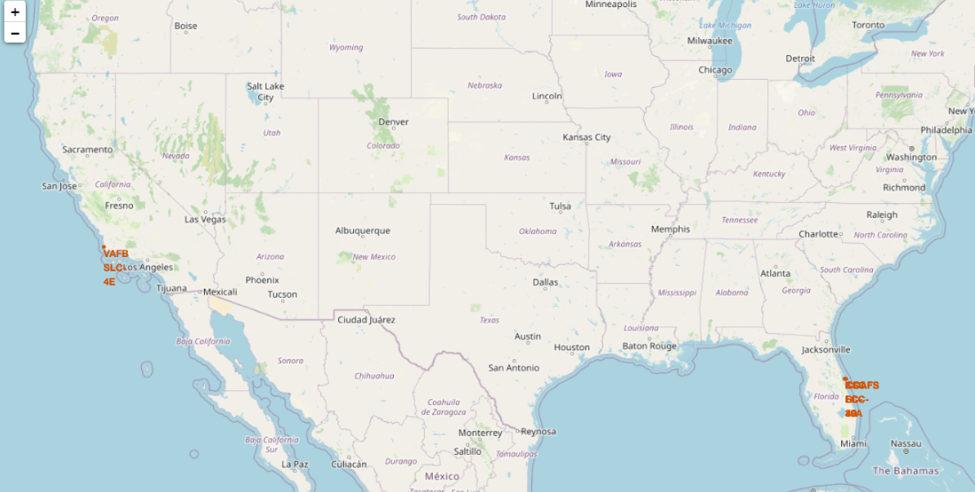
Global Locations of SpaceX Launch Sites (Map)

Slide 38
Global Locations of SpaceX Launch Sites
Key Observations:
Latitude & Equator Proximity: Most launch sites are north of the Equator, not in close proximity to it.
Coastal Location: Launch sites are very close to the coastline (sometimes within ~1 mile), ensuring rockets can safely launch over the ocean and minimize debris risk.
Safety & Accessibility: Sites are far from densely populated areas, reducing risk to people and infrastructure in case of launch anomalies.
Logistics Support: Nearby roads and railways facilitate transportation of rockets, fuel, and equipment.
Findings: SpaceX launch sites are strategically chosen to balance operational safety, logistical accessibility, and regulatory compliance, making them suitable for frequent, large-scale launches. The map clearly illustrates the global distribution and coastal proximity of all active launch facilities.

Slide 39
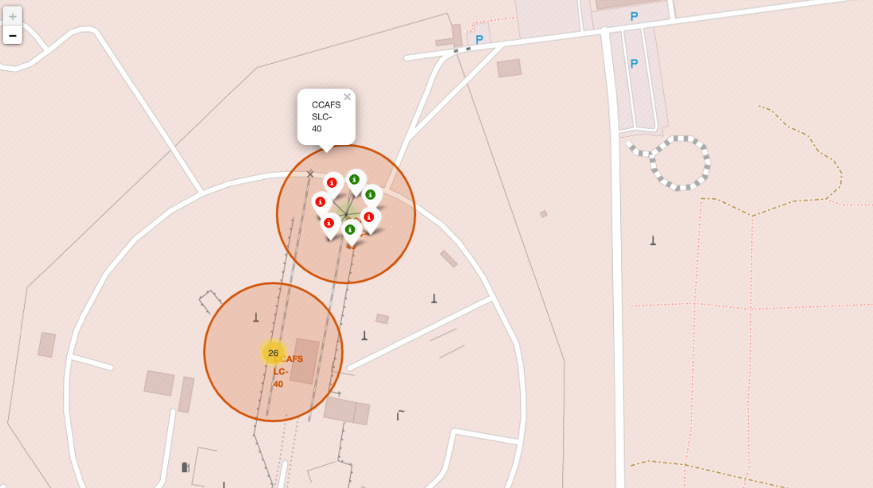
SpaceX Launch Outcomes by Location (Map)

Slide 40
SpaceX Launch Outcomes by Location
Key Observations:
Color-coded markers:
Green: Successful launches
Red: Failed launches
Marker Clusters: Grouped markers help visualize multiple launches at the same site without clutter.
Geographic Patterns: Some launch sites consistently show more green markers, indicating higher success rates.
Findings:
The map allows quick identification of site-specific performance and success trends.
Clusters of red markers indicate sites or periods with higher failure rates.
Overall, this visualization highlights the effectiveness of SpaceX launch operations across different locations, helping stakeholders quickly assess reliability and risk.

Slide 41
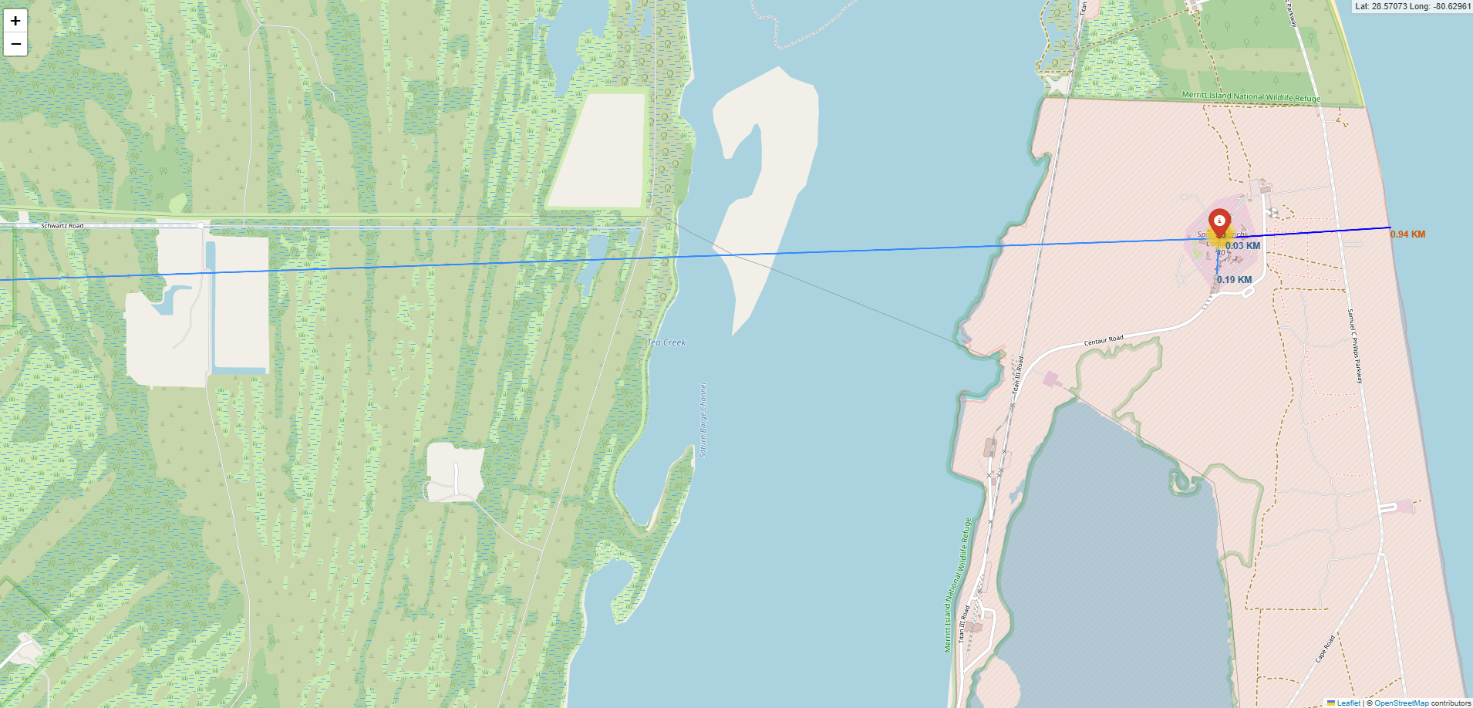
Proximity Analysis of Selected Launch Site (Map)

Slide 42
Proximity Analysis of Selected Launch Site
Key Observations:
Railways: The launch site is very close to a railway, supporting transport of heavy rocket components and logistical supplies.
Highways: Nearby highways provide flexible access for personnel, maintenance, and emergency services.
Coastline: Moderate distance from the coast ensures rockets launch over open water, minimizing risk to populated areas.
Cities: Launch site is far from major cities, reducing public safety risks from debris, noise, or accidents.
Findings:
Launch sites are strategically located to balance logistical efficiency, operational safety, and environmental considerations.
The map visually demonstrates how distance to key infrastructure and natural features supports safe and efficient launch operations.

Slide 43

Section 4

Slide 44
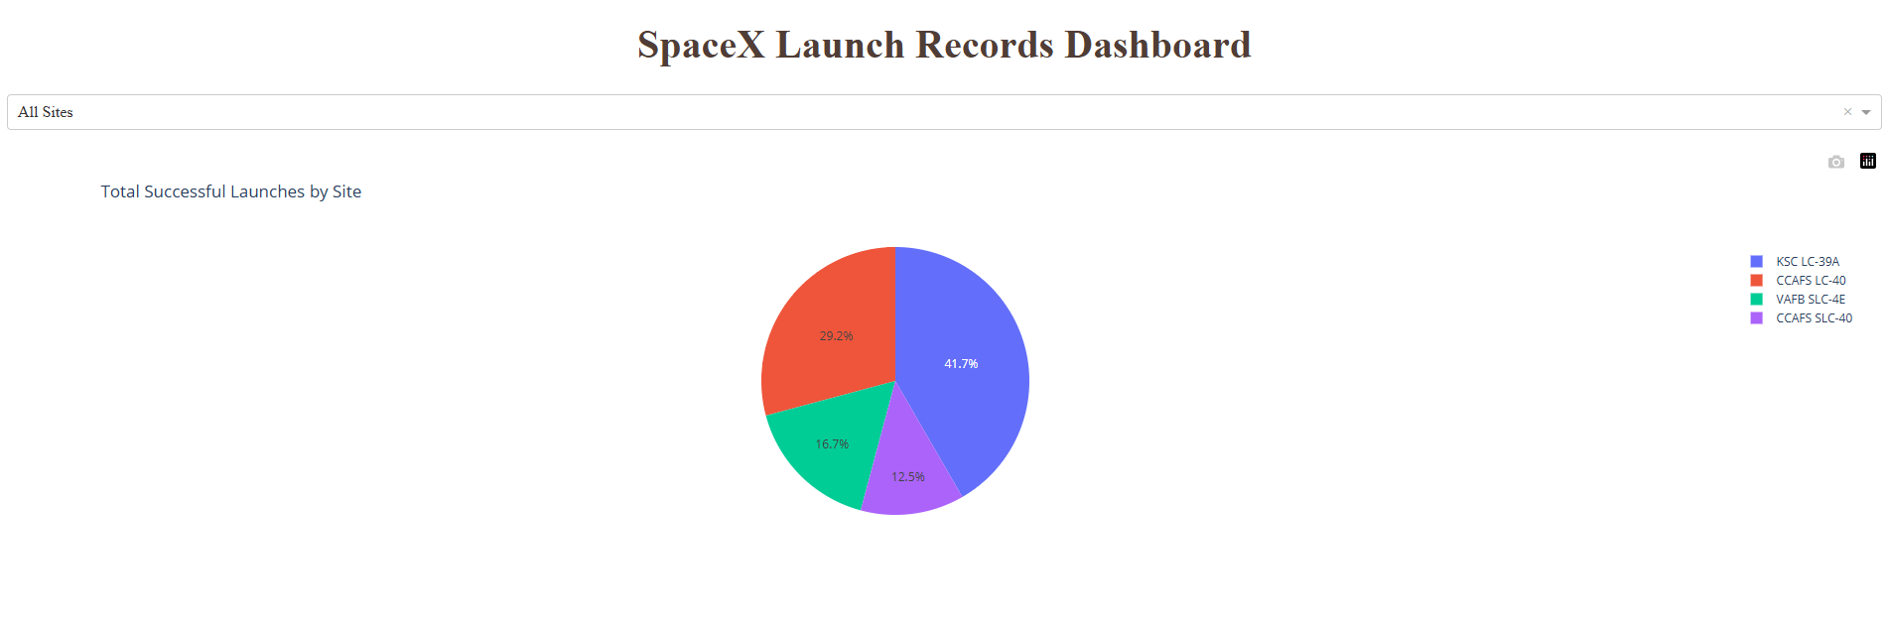
Launch Success Count by Site

Slide 45
Launch Success Count by Site
Key Observations:
KSC LC-39A has the largest number of successful launches, making it the most frequently and reliably used site.
CCAFS LC-40 also shows strong success performance despite a lower launch volume.
The pie chart clearly visualizes the distribution of successful launches across sites, allowing easy comparison.
Findings:
Site selection strongly influences mission success.
KSC LC-39A and CCAFS LC-40 demonstrate high reliability, reflecting both operational efficiency and historical performance.
Visualizing success counts in a pie chart helps stakeholders quickly assess which sites contribute most to SpaceX’s overall mission success.

Slide 46
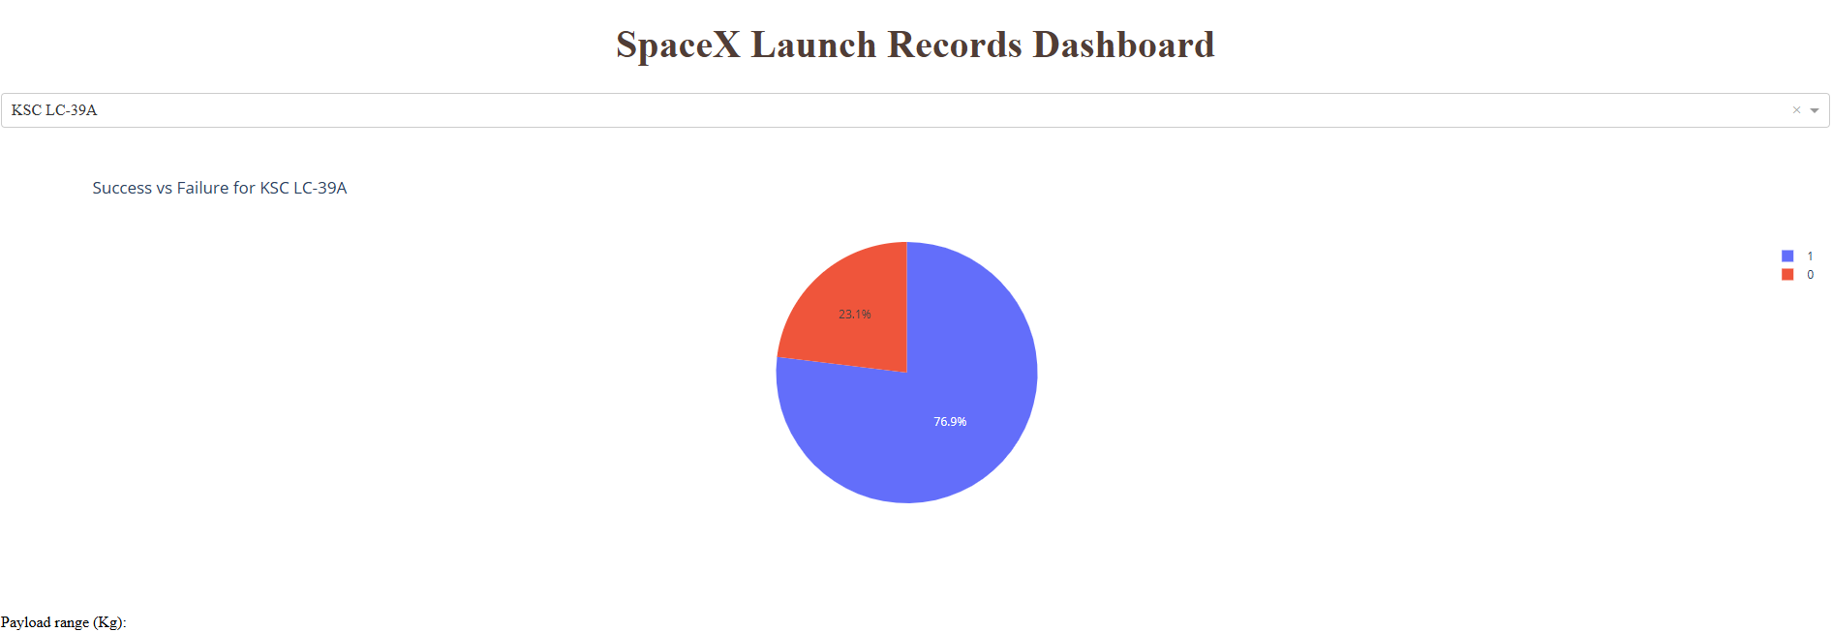
Launch Site with Highest Success Ratio

Slide 47
Launch Site with Highest Success Ratio
Key Observations:
KSC LC-39A shows the highest launch success ratio(76.9%) among all launch sites.
The pie chart clearly contrasts successful vs. unsuccessful launches for this site.
A dominant success segment indicates strong operational consistency.
Findings: The visualization confirms that KSC LC-39A is the most reliable launch site in the dataset. Its high success ratio reflects mature infrastructure, optimized launch procedures, and consistent mission execution, making it a preferred site for critical launches.

Slide 48
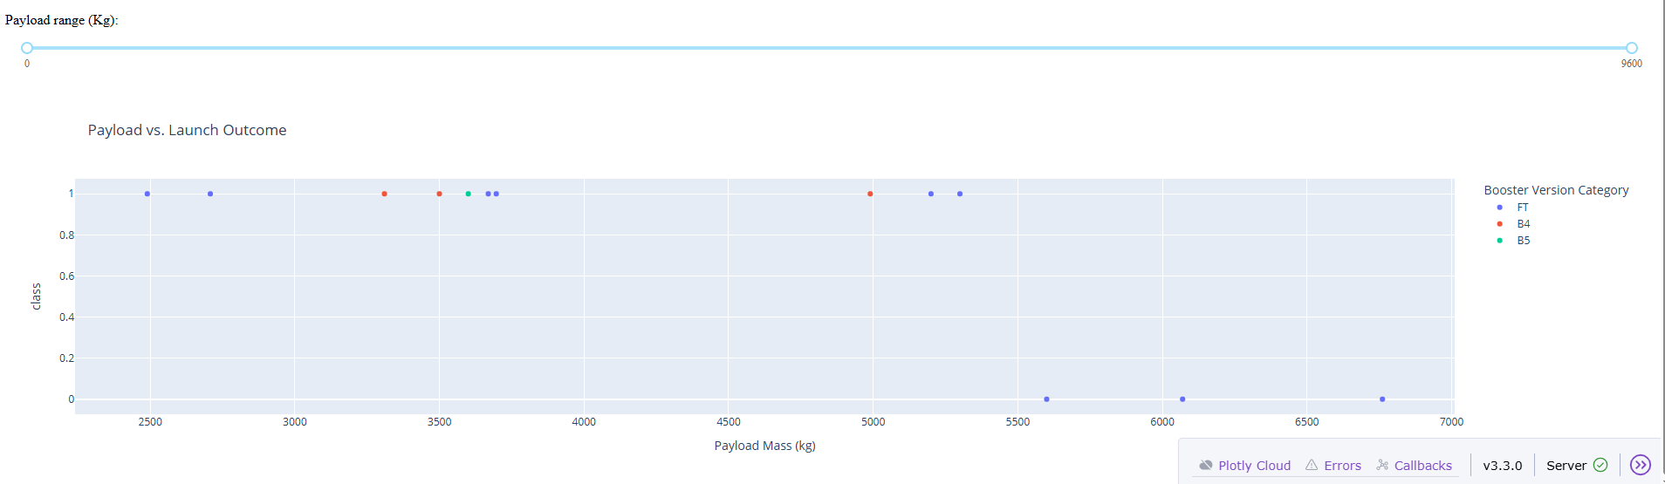
Payload vs Launch Outcome Analysis

Slide 49
Payload vs Launch Outcome Analysis
Key Observations:
The scatter plot shows payload mass on the X-axis and launch outcome (success/failure) on the Y-axis.
Using the payload range slider, success patterns change across different payload intervals.
Payloads in the 2,000–6,000 kg range show the highest concentration of successful launches.
Very low (<2,000 kg) and very high (>8,000 kg) payloads show relatively higher failure rates.
Findings:
Medium-weight payloads (2,000–6,000 kg) achieve the most consistent success across all sites.
Later booster versions, especially FT and Block 5, dominate successful launches in these payload ranges.
This visualization highlights how payload optimization and booster maturity play a critical role in launch success.

Slide 50

Section 5

Slide 51
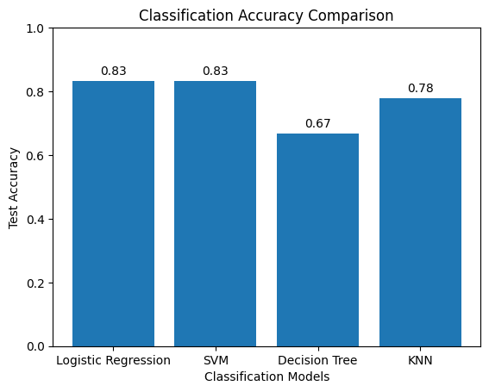
Classification Accuracy
Key Insights
Logistic Regression and SVM achieved the highest test accuracy (83.33%).
KNN performed moderately with 77.78% accuracy.
Decision Tree showed the lowest accuracy (66.67%) among all models.
Overall, linear models outperformed tree-based and instance-based approaches.
Best Model Selection
Logistic Regression was selected as the final model.
It provides high accuracy, model stability, and better interpretability compared to other classifiers.

Slide 52

Confusion Matrix Best Model: Logistic Regression
Confusion Matrix Explanation
True Positives (TP = 12): Launches correctly predicted as successful landings
True Negatives (TN): Launches correctly predicted as unsuccessful landings
False Positives (FP = 3): Predicted as landed but actually did not land
False Negatives (FN): Very few missed successful landings

Slide 53
Conclusions
Exploratory data analysis revealed strong relationships between launch success and payload mass, orbit type, launch site, and flight experience.
Interactive dashboards enabled dynamic exploration of launch outcomes across sites and payload ranges, improving analytical depth.
Predictive modeling demonstrated that classification algorithms can effectively predict first-stage landing success.
Logistic Regression achieved the highest and most consistent performance, making it the best predictive model for this task.

Slide 54
Appendix
Python notebooks for:
Exploratory Data Analysis (Visualization)
SQL-based data analysis
Machine learning classification models
SQL queries for payload aggregation, landing outcome analysis, and temporal filtering
Plotly Dash dashboard source code and interactive outputs
Supporting charts, confusion matrices, and model evaluation results
SpaceX launch dataset and processed data files
All supplementary materials are available in the project GitHub repository for reference
https://github.com/MuhammadAdeel-DataScientist/IBM-Applied-Data-Science-Capstone

Slide 55


